Slide 1

FORAGE VIRTUAL INTERNSHIP PROGRAM
WEB SCRAPPING TO GAIN INSIGHT
26/04/2023

Slide 2
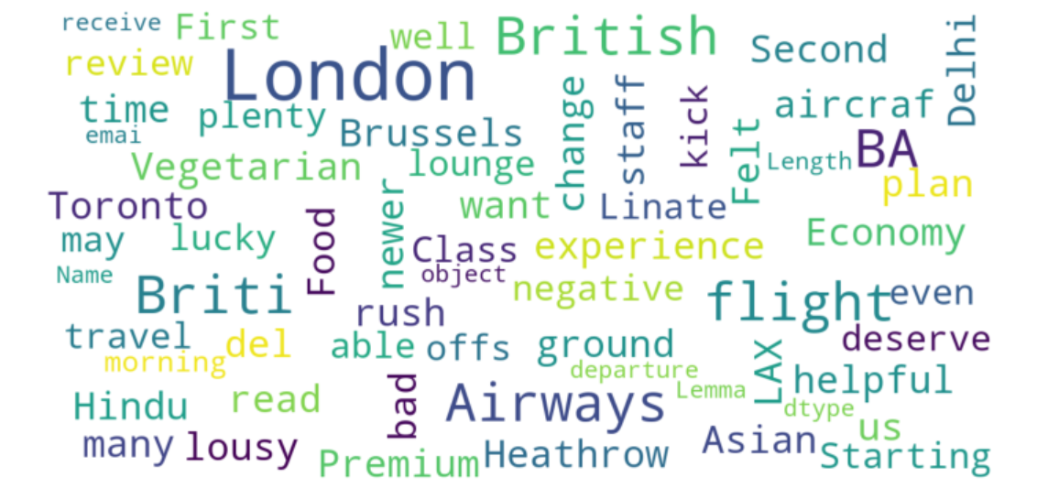
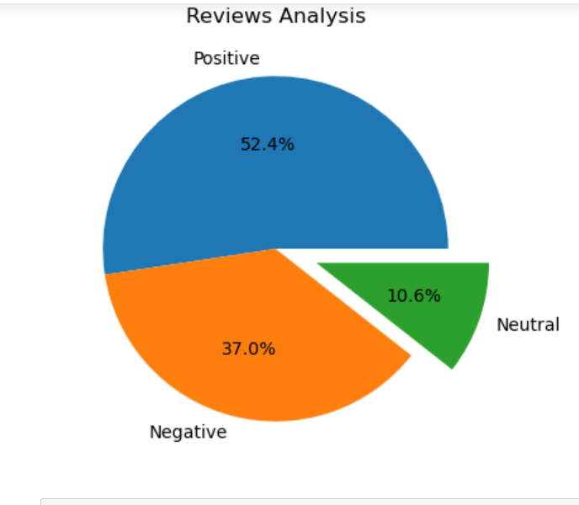
Scrapping and cleaning 1000 reviews from the customers review section, we obtained : Positive Reviews - 538 Negative Reviews - 347 Neutral Reviews – 115 from the sentimental analysis.
Sentiment chart
Word-cloud chart

